Slide 1
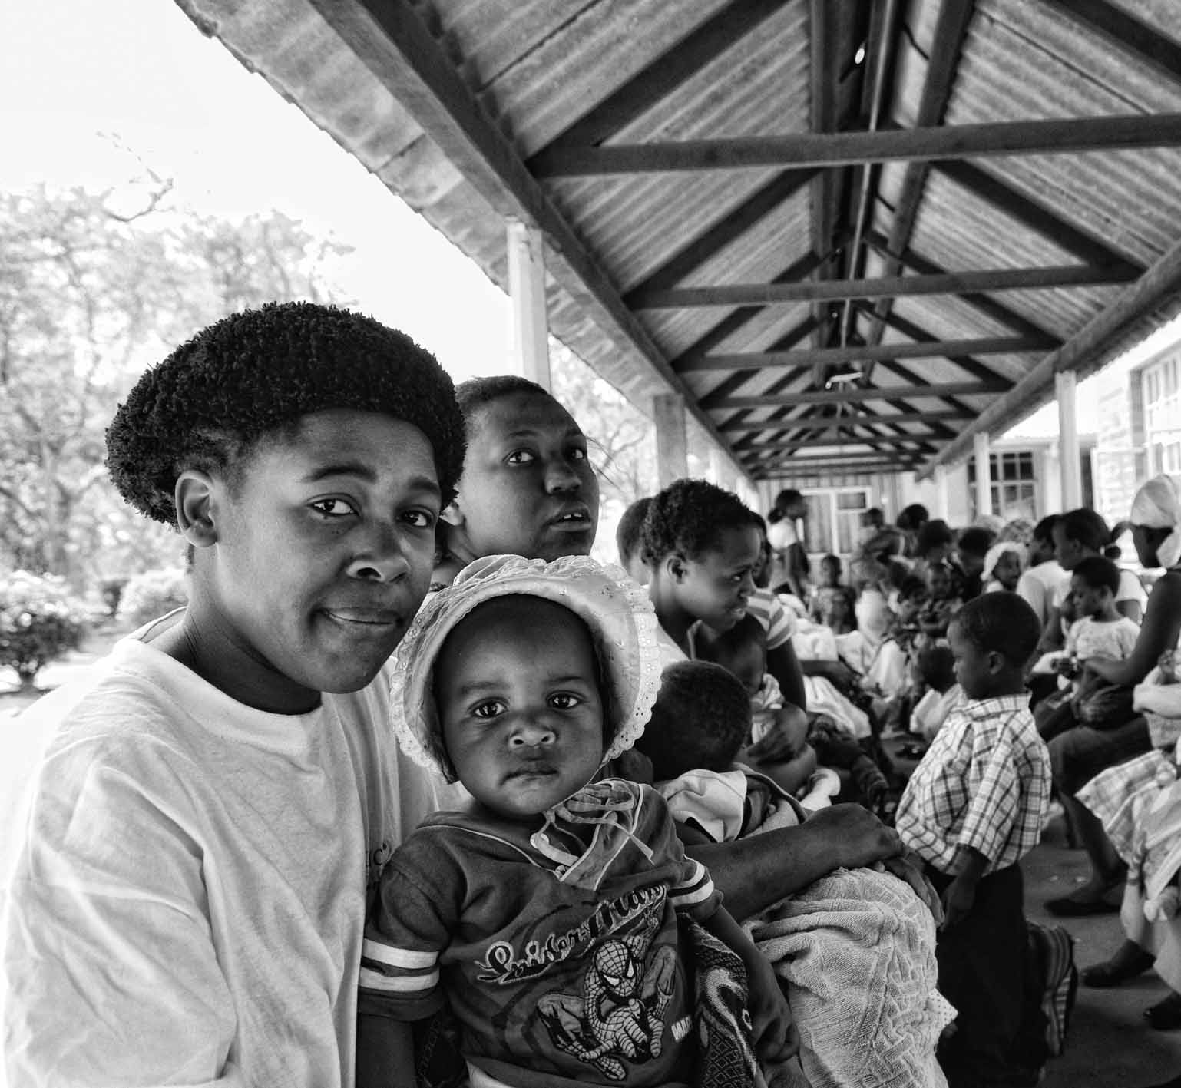
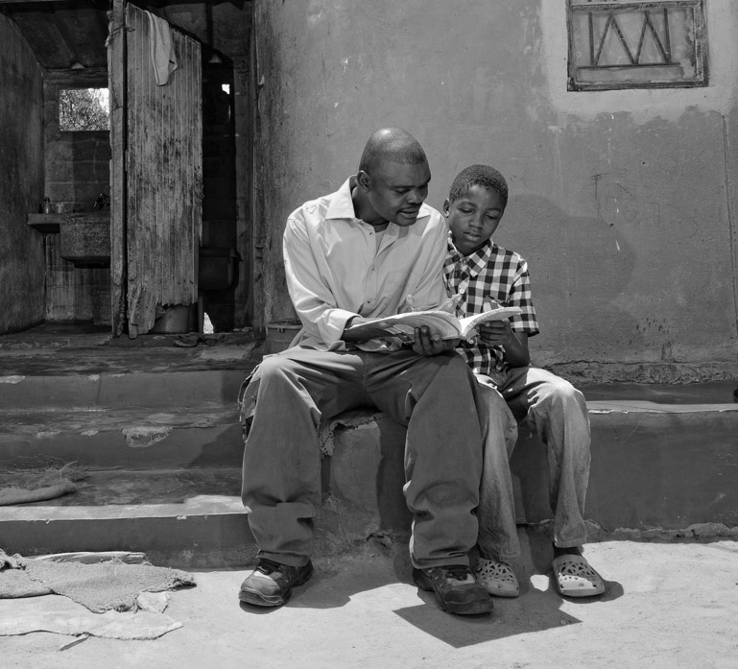
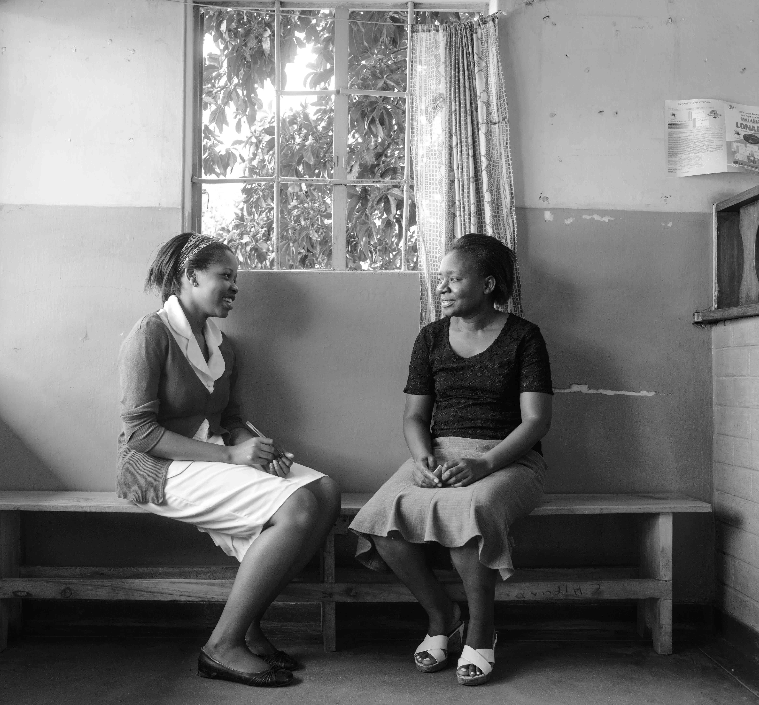
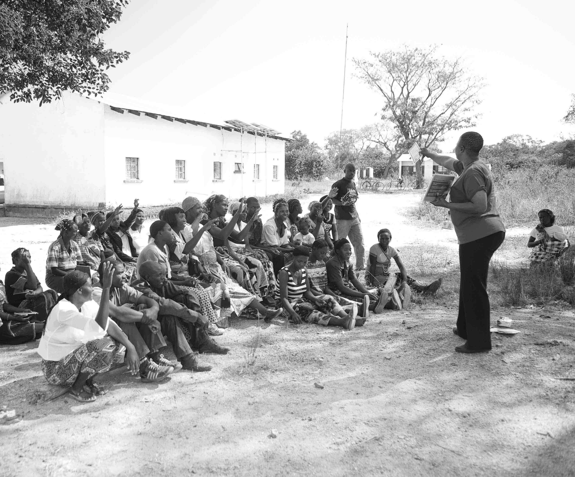
UNITAID PSI HIV SELF-TESTING AFRICA
Exploring the drivers of user costs as a barrier to accessing HIV Testing in rural Malawi
Linda Sande- MLW/LSHTM
IAEN - Amsterdam 21-July-18

Slide 2
Malawi progress towards 90-90-90
HIV testing is an essential gateway to HIV prevention and treatment services by influencing people’s prevention or treatment decisions after knowledge of their status.
Source: UNAIDS, 2017
Notes:
90-90-90 is an ambitious target of ending the AIDS epidemic by the year 2030. It seeks to ensure that globally, 90% of PLHIV will be aware of their HIV+ status, 90% of them will be on sustained ART and 90% of them will have achieved viral suppression

Slide 3
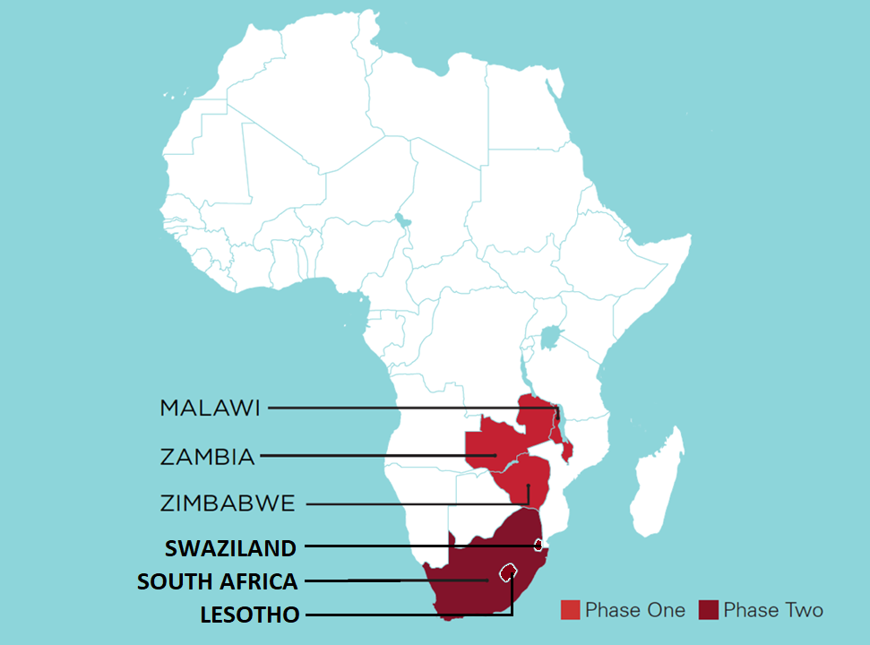
UNITAID/PSI HIV Self-Testing AfRica - STAR Project
HIV self-testing (HIVST) has the potential to move countries towards 90-90-90
STAR is a multi-country trial aimed at catalysing the market of oral HIVST

Slide 4
Objectives
We sought to examine:
Costs borne by users of HIV Testing Services (HTS) in rural Malawi;
Variation in costs by population subgroups
Whether costs differ by testing mode.

Slide 5
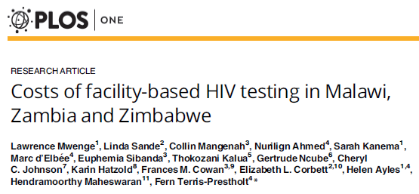
Perspective
Facility HTS costs used a provider’s perspective.
Societal perspectives captures full costs (resource use) to society, including user costs.
Providers’ perspective is useful for budgeting, but need to understand user costs as barrier to access and opportunity cost.
May have multiple providers: Government; NGO, etc..
Mangenah et al. (2018). Costs of Community-Based Distribution of HIVST Unpublished

Slide 6
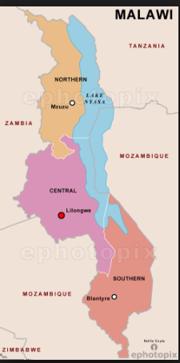
Baseline Costs Household Survey
4 districts in Southern Malawi
Baseline survey:
May-August 2016
Random sample of households.
All household members were >16 years & tested in last 12 months
N=746
emapsworld (2018)

Slide 7
Assessing costs and location of HIV testing
Cost questions
Direct costs: Transport, consultation, food, any other costs
Indirect costs: child care, lost income
Other questions:
Testing location: facility- or community-based
If their most recent test was accessed separately from other health services or as part of antenatal care ANC or PITC
Total time taken to access the test

Slide 8
Regression Analysis
User costs estimation challenges:
Spike at zero
Strictly positive values
Skewed
Common estimation options are: log-transformed OLS, Tobit, TPM & GLM
TPM effectively handles excess zeroes and positive distribution

Slide 9
TPM Regression
${{Logit }_{0 if {TC}_{i}=0}^{1 if {TC}_{i}>0}}=$
$$f\left[\begin{aligned}{District}_{i},{Gender}_{i},{Wealth}_{hh},{Age}_{i},{Education}_{i}, \\ \begin{aligned}Test location,{Hours taken}_{i}, \\ {\# children}_{i},PITC\end{aligned}\end{aligned}\right]$$
OLS $\ln\left({Total Costs}_{i}\right)=$
$$f\left[\begin{aligned}{District}_{i},{Gender}_{i},{Wealth}_{hh},{Age}_{i},{Education}_{i}, \\ \begin{aligned}Test location,{Hours taken}_{i}, \\ {\# children}_{i},PITC\end{aligned}\end{aligned}\right]$$

Slide 10
Results: Mean unit costs
Cost Category | Men (US$) | Women (US$) | Mean (Total Sample) | % age
Transport | 0.25 | 0.16 | 0.19 | 8%
Consultation | 0.03 | 0.03 | 0.03 | 1%
Food | 0.18 | 0.13 | 0.14 | 6%
Other | 0.05 | 0.02 | 0.03 | 1%
Child Care | 0.06 | 0.01 | 0.03 | 1%
Lost Income | 3.24 | 1.48 | 2.03 | 83%
Total Cost | 3.81 | 1.83 | 2.45 | 100%
~71% live on less than US$1.90 a day

Slide 11
Determinants (Reference Group) |  | Two-Part Model (n = 746)
 |  | Logit | Log-transformed OLS
Sex (Male) | Female | -0.221 | -0.517***
Wealth (Lowest Quintile) | 2nd Quintile | -0.196 | -0.0113
 | 3rd Quintile | -0.108 | 0.398***
 | 4th Quintile | -0.168 | 0.0644
 | 5th Quintile | 0.342 | 0.161
Age (16-19) | 20-24 | 0.468 | 0.610***
 | 25-39 | 0.777** | 0.964***
 | 40-64 | 0.674 | 1.031***
 | 65+ | -0.323 | 0.736***
Education (No Formal Edu.) | Primary Edu. | 0.177 | -0.0569
 | Incompl. Sec. Edu. | 0.430 | 0.248
 | Complete Sec. Edu | 0.951 | 0.628***
*** p<0.01, ** p<0.05, * p<0.1
117% higher odds

Slide 12
Determinants (Reference Group) |  | Two-Part Model (n = 746)
 |  | Logit | Log-transformed OLS
#Children | # Children | 0.060 | -0.0164
Testing Location | Community Testing | -0.946*** | -0.204
(Facility incl. PITC) | Other location | -0.820 | 0.0617
Time Taken | Hours | 0.203*** | 0.0161
Reason for visiting | HIV Test | 0.393* | 0.0374
District (Blantyre) | Machinga | 0.253 | 0.0857
 | Mwanza | 0.666* | 0.434***
 | Neno | -0.190 | 0.0594
 | Constant | -0.0902 | -0.118
*** p<0.01, ** p<0.05, * p<0.1
61% lower odds
23% higher odds
18% higher odds
95% higher odds

Slide 13
Conclusion
Rural testers in Malawi incur significantly high costs
Men incur costs twice as high as women
A large proportion of total costs associated with lost income was driven by long travel times and long waiting times at testing facilities (3.34 hours)
Both individual and institutional factors drive user costs
Strength:
We explored user costs and their cost drivers to rural testers
Limitations:
Potential recall bias
Potential exclusion of individuals with prohibitive costs such that they don’t test

Slide 14
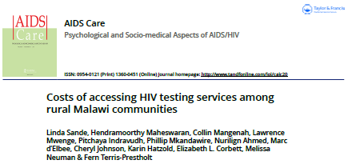
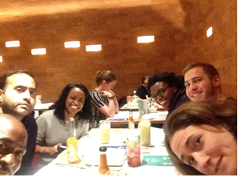
Thank you for your attention.
Linda Sande
Research Degree Student
LSHTM/MLW
linda.sande@lshtm.ac.uk
Linda Sande, Hendramoorthy Maheswaran, Collin Mangenah, Lawrence Mwenge, Pitchaya Indravudh, Phillip Mkandawire, Nurilign Ahmed, Marc d’Elbee, Cheryl Johnson, Karin Hatzold, Elizabeth L. Corbett, Melissa Neuman and Fern Terris-Prestholt

