Slide 1
Accessing Male Circumcision with No or Less Cost in Namibia and Lesotho
8th International AIDS Economics Network
Pre-Conference Meeting
July 19, 2014
Melbourne, Australia
Tigistu Adamu Ashengo MD, MPH
Associate Medical Director
Jhpiego

Slide 2
Presentation Outline
Lesotho: Motivators and barriers of VMMC service utilization
Namibia: How Leveraging the Private Health Sector Supports Scaling up VMMC
Lessons Learned
Notes:
IRL

Slide 3
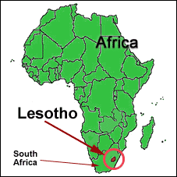
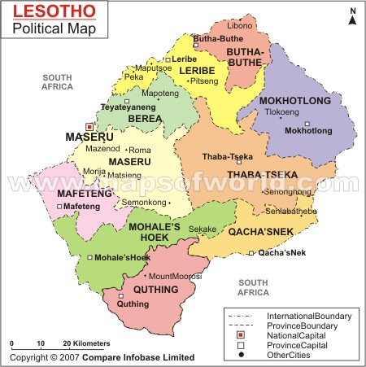
The Lesotho Context
Population: 1.8M (census 2006)
23.8% urban vs 76.2% rural
Population growth rate: 2.5 (1986); 1.5 (1996); close to 0 (2006)
Capital: Maseru
Geography: Low lands and highlands (poor accessibility)
Economy: Minimal arable land, migrant mine workers, textiles
Notes:
Migrant mine workers with TB cannot be resent and therefore will hide their diseases

Slide 4
The Population of Lesotho
>360,000 people living with HIV
HIV prevalence: 23%
Over 25,000 new HIV infections annually, stable
HIV prevalence among pregnant women is 24.3%
TB/HIV co-infection is 74%
HIV prevalence among SW, MSM and IDUs is unknown; prisoners–31%; factory workers–42.7%
New infections occur mostly within stable relationships (MCP)

Slide 5
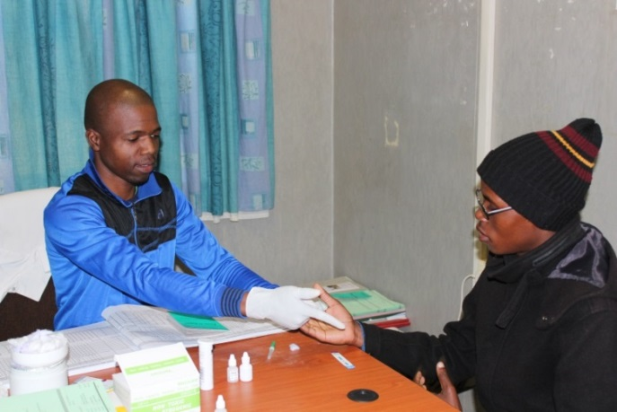
VMMC Program in Lesotho
Modeling: 5 MCs can avert 1 HIV infection
Services are health facility-based: Hospitals and health centers (potential for continuum of care)
VMMC free of charge
Package of services: HTC, STI screening and Rx, condom provision, health education, and linkage to HIV care and treatment

Slide 6
VMMC program in Lesotho
National coverage: MCs: more than 50,000 (national target: 320,000)
More than 80% of clients are under 24; more than 95% test for HIV
HIV-positive: 6%; (20% at adult clinic)
Low rate of adverse events: 0.8 -1.0 %
310 doctors, nurses and counselors trained

Slide 7
Perceived Reasons Preventing Men from Accessing MC in Lesotho
Perceptions | Maseru Urban Clinics (Carewell, Apex) N=73 | Non-Maseru Rural Clinics (Ntsekhe, Mokhotlong) N=88 | Total N=161
 | n (%) | n (%) | n (%)
Long wait time | 4 (5.5) | 1 (1.1) | 5 (3.1)
Mixing young and old clients | 2 (2.7) | 3 (3.4) | 5 (3.1)
Being attended to by female staff | 7 (9.6) | 22 (25.0) | 29 (18.0)
HIV testing | 15 (20.6) | 9 (10.2) | 24 (14.9)
Fear of pan | 45 (61.6) | 46 (52.3) | 91 (56.5)
Fear of injection | 4 (5.5) | 5 (5.7) | 9 (5.6)
Long healing time, abstinence | 3 (4.1) | 4 (4.6) | 7 (4.4)
Concern about MC safety | 3 (4.1) | 2 (2.3) | 5 (3.1)
Preference for traditional MC | 2 (2.7) | 5 (5.7) | 7 (4.4)
Lack transport fare | 8 (11.0) | 7 (8.0) | 15 (9.3)

Slide 8
Out-of-Pocket Expenses
A client is expected to spend about $17 just for transportation to access circumcision services (typically involves three visits to health facility)
22% of the annual $75 out-of-pocket expenditure that a typical Basotho usually spends on health
This expense occurs despite efforts to provide the service and any medications free of charge
Addressed by bringing VMMC services closer to where clients live, through outreaches and Intensive Service Delivery (ISD)

Slide 9
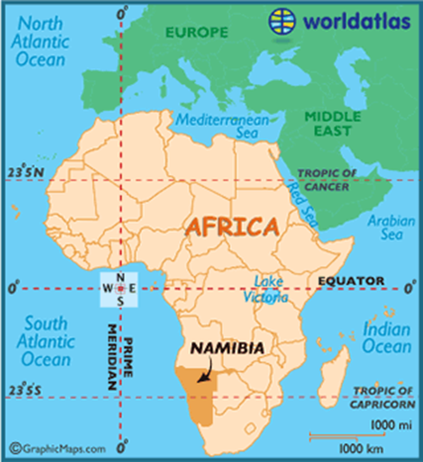
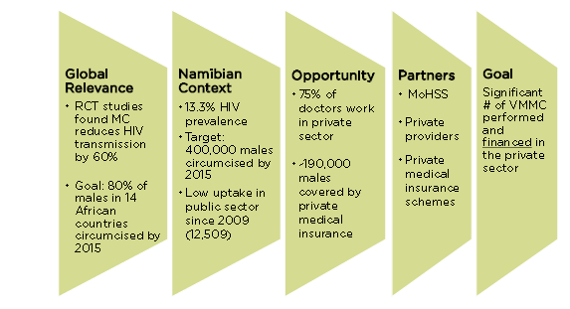
Namibia Context

Slide 10
Large Private Health Workforce to Leverage
47% of health workforce practices in the private sector
Public sector: 2.0 per 1,000 inhabitants
Private sector: 8.8 per 1,000 inhabitants
Category | # Registered 2006/2007 | Public Sector |  | Private Sector
 |  | # | % | # | %
Doctors | 774 | 216 | 28 | 558 | 72
Registered nurses | 2989 | 1626 | 54 | 1363 | 46
Enrolled nurses | 2761 | 1884 | 68 | 877 | 32
Pharmacists | 239 | 27 | 11 | 212 | 89
Pharmacist Asst. | 137 | 65 | 47 | 72 | 53
Social Workers | 250 | 76 | 30 | 174 | 70
Source: MOHSS Health and Social Services System Review 2008
Notes:
IRL
Maximum of 25% actually accessing the private sector
(ONLY IF ASKED: Private sector employees most likely include NGO’s / faith based workers)

Slide 11
Expanding Private Health Insurance Coverage Sustains Access
Willingness and ability to pay for private services not fully utilized
Approximately 334,000 Namibians enrolled in private medical insurance
Only around 51% of formally employed are insured (18% of population)
Source: NAMAF 2010 (not published)
Notes:
IRL

Slide 12
Covering VMMC through Private Health Insurance Expands Access
MC technical working group launches national strategy 2010
With input from SHOPS, strategy includes explicit private sector role
Developed MC tariff (rate) for health insurance
VMMC training curriculum for private doctors developed
Namibian insurers accepted proposal in October 2011
MC covered as an explicit benefit as of January 2012
Notes:
Example of how a country program is supporting sustainability of MC initiative
-SHOPS sits on the Male Circumcision Technical Working Group which is led by the MoHSS- private sector representative
-MC TWG shared strategy with stakeholders- country led
-SHOPS developed tariff: Deloitte South Africa provided actuarial analysis to establish the rate. Jhpiego, SHOPS partner, provided the clinical assumptions to make sure that the inputs were in accordance to WHO guidelines.
-We have not received any signals that any medical aids are planning to exclude the benefit in 2012 (although they have right to do so since Namibia does not have prescribed minimum mandatory benefits)
-Next steps: work with MoHSS to train private providers to deliver high quality VMMC according to national guidelines

Slide 13
Leveraging Private Sector Resources to Provide and Finance VMMC
Results
Reduced VMMC cost from $1200 to $200 9/10 health insurance schemes providing VMMC as benefit Improved value for money
USG VMMC Investments in Namibia
 | Public sector | Private Sector
Duration | 3 years | 1.5 years
USG Total Investment | $6,600,000 | $327,000
MCs Provided | 12,509 | 1,839
VFM | $527/MC | $178/MC*
*MC provision in the private sector is funded by health insurance schemes

Slide 14
Lessons Learned
Access to freely provided services is still costly for many in rural Lesotho and Namibia
Scale up requires addressing such barriers for clients
In selected places insurance schemes may increase utilization of VMMC services and increase the value for money
Private sector can play a significant role in scale up of VMMC services
Engaging private sector through training will help reduce the cost of care in private facilities

Slide 15
Applying Lessons in Other Contexts
Adapt models to provision of VMMC services closer to where people Live
Look at methods to reduce the costs of health insurance for the formally employed even in nascent markets
Beyond VMMC: identify which PEPFAR-funded services could be added to national mandatory or prescribed benefit lists under private health insurance

Slide 16
Thank you
www.jhpiego.org
www.mchip.net
www.shopsproject.org

