Slide 1

Costing Harm Reduction in Eastern Europe and Central Asia
Prepared by Dasha Ocheret and Nora Kriauzaite, Eurasian Harm Reduction Network
Presented by Danielle Parsons, APMGlobal Health
Improving health and protecting human rights
for individuals, communities, and society

Slide 2

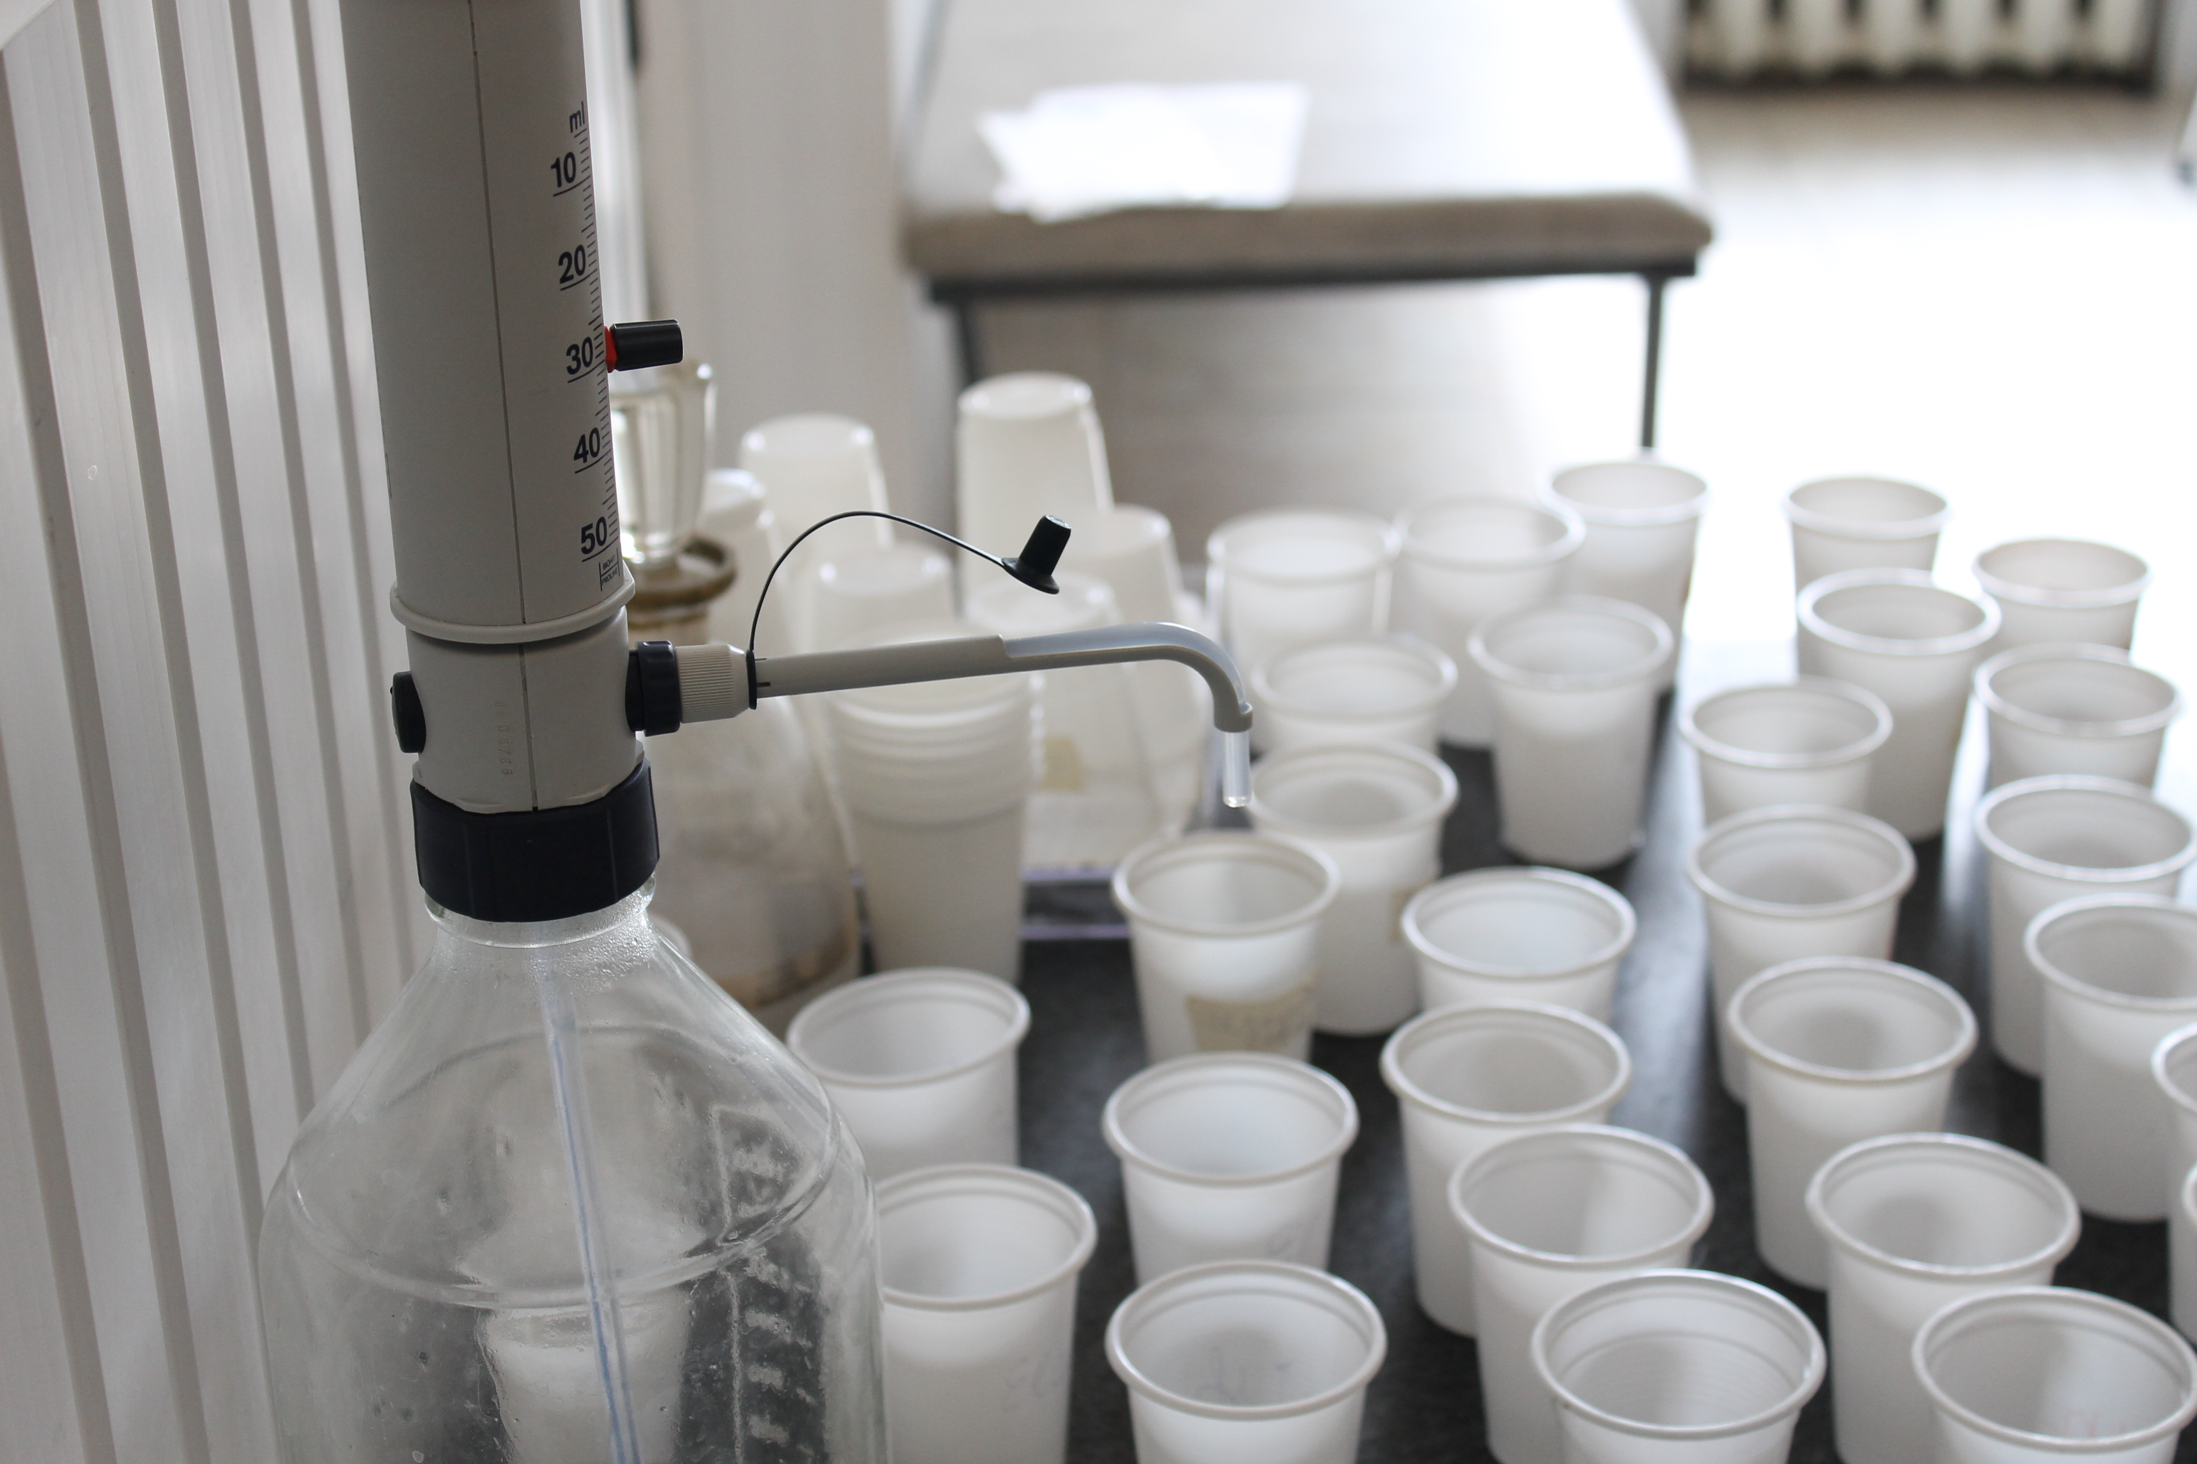
Refresher: What do we mean by harm reduction?
WHO, UNODC and UNAIDS recommend 9 interventions for the prevention, care and treatment of HIV amongst people who inject drugs:
Needle and syringe programs (NSP)
Opioid substitution therapy (OST)
HIV counseling and testing
Antiretroviral therapy (for PWID who are living with HIV)
Prevention and treatment of sexually transmitted infections
Condoms programs targeted specifically at PWID and their sexual partners
Targeted information, education and communication (IEC) materials and campaigns for PWID and their sexual partners
Vaccination, diagnosis and treatment of viral hepatitis (including HAV, HBV, HCV)
Prevention, diagnosis and treatment of tuberculosis

Slide 3
Transition from international donor support to national funding
The Global Fund is decreasing its support to the Eastern Europe and Central Asia (EECA), as countries transit from low- to middle- and high-income countries.
The share of national funding for HIV/AIDS is increasing, but:
  Mainly for treatment - 68% worldwide, and 81% in EECA (UNAIDS),
  Not for HIV prevention - 14% for HIV prevention in low- and middle-income countries (UNAIDS) and
  Even less for harm reduction programs (no exact data available).
To enable transition to sustainable funding without reversing positive trends in HIV prevention, EECA needs:
  Robust data on how much is needed for harm reduction to achieve 50% reduction of HIV incidence among people who use drugs, and
  Political support and access to budgeting processes.

Slide 4
How much money we need for harm reduction in EECA?
Example: Is harm reduction investment in Georgia really 20% higher than in Ukraine?
Or are different approaches used to assess the level of expenditure?
No one knows
Data on how much has been spent is missing:
  Irregular country reports and incomplete reports for National AIDS Spending Accounts (NASA) and GARPR reporting
  GARPR doesn’t provide reliable data on actual spending for harm reduction
Full demand has been never carefully assessed.
Ukraine | Georgia
3 772 542 USD annual spending for harm reduction (2010 data, UNAIDS) | 4 234 431 USD annual spending for harm reduction (2012 data, UNAIDS)
76 needle and syringe programs (NSP) 159 385 NSP clients 149 opioid substitution treatment (OST) sites 7339 OST clients | 10 NSP 3137 NSP clients 18 (OST) sites 1544 OST clients

Slide 5
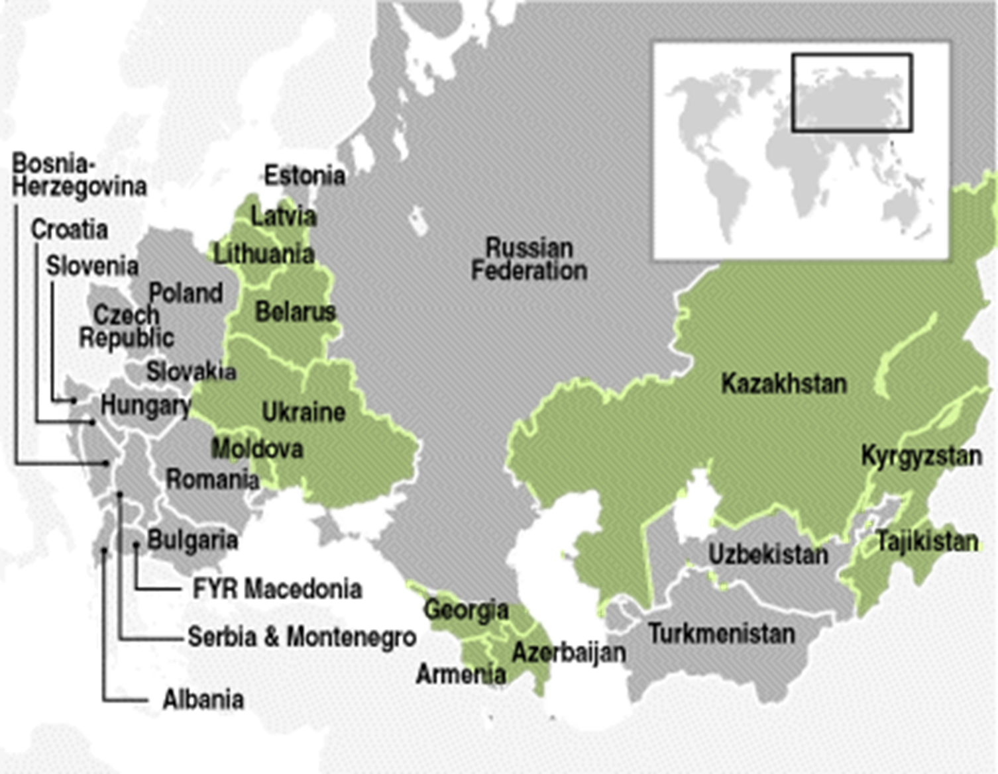
EHRN regional initiative “Harm Reduction Works: Fund It!”
Funded by the Global Fund (6 million USD)
April 2014 – April 2017 (3 years)
5 target countries from 11 eligible:
Azerbaijan
Armenia
Belarus
Georgia
Kazakhstan
Kyrgyzstan
Latvia
Lithuania (alternate)
Moldova
Tajikistan
Ukraine*
*Special status of Ukraine. Organizations from Ukraine are not eligible to be sub-recipients (SR) within the Regional program.

Slide 6
Regional Initiative Goals & Objectives
Goal
To strengthen advocacy by civil society, including people who use drugs, for sufficient, strategic and sustainable investments in harm reduction as HIV prevention in the region of Eastern Europe and Central Asia.
Objective 1: To build an enabling environment for sufficient, strategic and sustainable public and donors’ investments in harm reduction (HR).
Objective 2: To develop the capacity of the community of people who use drugs to advocate for availability and sustainability of harm reduction services that meet their needs.

Slide 7
Regional Initiative Timeline
Year 1:
  Assess the level of current funding for harm reduction
  Together with drug user community find ways to increase efficiency and optimize resource spending
  Assess full demand for optimized harm reduction services
Years 2-3:
  Regional level: Advocate for international donor coordination to achieve smart transition --- REGIONAL TRANSITION PLAN
  National level: Advocate for smart transition from international donor to national funding – NATIONAL TRANSITION PLAN

Slide 8

Year 1: Cooperation between EHRN and the Futures Group
March - July 2014: development of draft methodology for unified regional approach to assess harm reduction costs and expenditures
July 2014: piloting in Tajikistan (100% international funding), Lithuania (100% public funding) and Georgia (mixture of international, public and out-of-pocket payments)
August - November 2014: harm reduction expenditure and costs assessment in 5 target countries
March 2015: regional and national reports

Slide 9
Known Challenges in Costing Harm Reduction
No unified methodology for NSP and OST costs
No consensus on including indirect costs:
  Example: In Count the Costs: Romania Country Report (2013) wages, administrative and other indirect costs are excluded
No consensus on unified approach for NGO vs. public services costs:
  Example: Getting information of NGOs staff training is possible; but how do we calculate training costs for public services staff?
No unified definition of harm reduction service package:
  Example: Do we include HIV testing into NSP costs? Overdose prevention (naloxone)?
  Example: Do we include social support into OST costs?

Slide 10
How we define harm reduction services
Defined for local/national needs
Community-based assessment by people who use drugs define each service as high, medium or low priority
  Small grants and unified methodology are used to involve representative subgroups of drug users into the consultation process)
Itemization for NSP
Needle and syringe distribution and exchange
Social work and counseling
HIV test and pre- and post-testing counseling
TB screening and diagnosis
TB DOT
STI diagnostics
STI treatment
Group sessions and support groups
Legal services
Gender sensitive services
Overdose prevention
Case management
Medical consultation

Slide 11
Costing approach

Slide 12
Challenges In Implementation So Far
Lack of understanding of goals of the assessment among local partners
General distrust to disclose financial information
  Resistance of public service provision managers to share expenditure information, especially on salaries, training costs
Lack of knowledge on time dedicated per client by medical staff
Slow response rate for requested data
  Should we attempt to verify and validate data quality? If so, how?

Slide 13
For more information, contact:
Dasha Ocheret - dasha@harm-reduction.org
Nora Kriauzaite - nora@harm-reduction.org
www.harm-reduction.org
----
Danielle Parsons – danielle@apmglobalhealth.com
www.apmglobalhealth.com

